Slide 1
Deep Learning
Transfer Learning

Slide 2
Table of Contents
What Is Transfer Learning?
How Does Transfer Learning Work?
Why Is Transfer Learning Used?
When Should Transfer Learning Be Used?
Approaches to Transfer Learning
Types
Methodologies
Diving into Transfer Learning
Challenges

Slide 3
WHAT IS TRANSFER LEARNING?
Def: Model A is successfully trained to solve source task T.a using a large dataset D.a. However, the dataset D.b for a target task T.b is too small, preventing Model B from training efficiently. Thus, we use part of model A to predict results for task T.b.
A common misconception is that training and testing data should come from the same source or be with the same distribution.
Using transfer learning, we are able to solve a particular task using full or part of an already pre-trained model on a different task.

Slide 4
WHAT IS TRANSFER LEARNING?
Transfer learning, used in machine learning, is the reuse of a pre-trained model on a new problem.
In transfer learning, a machine exploits the knowledge gained from a previous task to improve generalization about another.
Example1, in training a classifier to predict whether an image contains food, you could use the knowledge it gained during training to recognize drinks.
Example2, in training a classifier to predict whether an image contains a backpack, you could use the knowledge that the model gained during its training to recognize other objects like sunglasses.

Slide 5
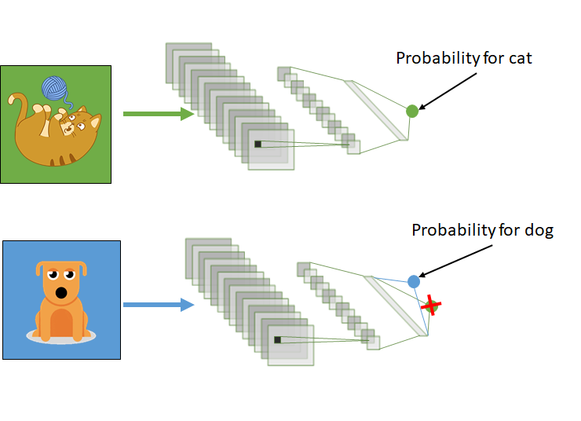
WHAT IS TRANSFER LEARNING?
With transfer learning, we basically try to use what we’ve learned in one task to better understand the concepts in another. weights are being automatically being shifted to a network performing “task A” from a network that performed new “task B.”
Because of the massive amount of CPU power required, transfer learning is typically applied in computer vision and natural language processing tasks like sentiment analysis.

Slide 6
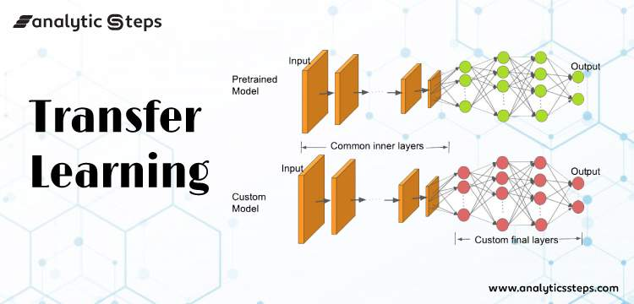
How Transfer Learning Works?
In computer vision, neural networks typically aim to detect edges in the first layer, forms in the middle layer, and task-specific features in the latter layers.
The early and central layers are employed in transfer learning, and the latter layers are only retrained. It makes use of the labelled data from the task it was trained on.
Let’s return to the example of a model that has been intended to identify a backpack in an image and will now be used to detect sunglasses. Because the model has trained to recognise objects in the earlier levels, we will simply retrain the subsequent layers to understand what distinguishes sunglasses from other objects.

Slide 7
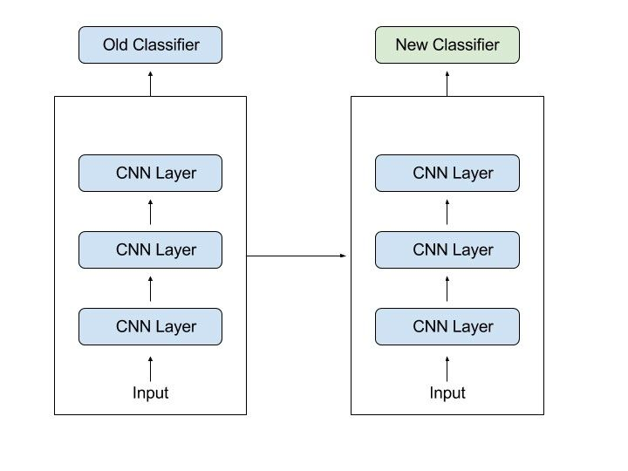
Why Should You Use Transfer Learning?
Transfer learning offers a number of advantages, the most important of which are reduced training time, improved neural network performance (in most circumstances), and the absence of a large amount of data.
To train a neural model from scratch, a lot of data is typically needed, but access to that data isn’t always possible – this is when transfer learning comes in handy.
Because the model has already been pre-trained, a good machine learning model can be generated with fairly little training data using transfer learning. This is especially useful in natural language processing, where huge labelled datasets require a lot of expert knowledge. Additionally, training time is decreased because building a deep neural network from the start of a complex task can take days or even weeks.

Slide 8
When to use transfer learning?
Transfer learning is becoming the go-to way of working with deep learning models. The reasons are explained below.
Lack of data : Deep learning models require a LOT of data for solving a task effectively. However, it is not often the case that so much data is available. For example, a company may wish to build a very specific spam filter to its internal communication system but does not possess lots of labelled data.
In that case, a specific target task can be solved using a pre-trained model for a similar source task.
The tasks can be different but their domains should be the same.
In other words, you are unable to do transfer learning between speech recognition and image classification tasks since the input datasets are of different types.
What you can do is using a pre-trained image classifier on dog photos to predict cat photos.

Slide 9
When to use transfer learning?
Speed
Transfer learning cuts a large percentage of training time and allows for building various solutions instantly. In addition, it prevents from setting up a complex and costly Cloud GPU/TPU.
Social good
Using transfer learning positively impacts the environment.
According, to a study in the MIT Technology Review, a large neural network (200M+ parameters) trained on a Cloud TPU produces CO2 equivalent to ~6 cars during their lifetime. Transfer learning can prevent the extensive usage of these powerful processing units.

Slide 10
Advantages :
Improved performance: Deep transfer learning can improve the performance of a model on a new task by leveraging the knowledge learned from the pre-trained model. This is because deep neural networks have many parameters and are able to learn complex representations of data, so they can be fine-tuned to perform well on a new task.
Reduced training time: It can save time and computational resources by avoiding the need to train a model from scratch.
Handling limited data: It can be useful when there is limited labeled data available for a new task, as the pre-trained model can provide a good starting point for fine-tuning.

Slide 11
Advantages :
Improved performance: Deep transfer learning can improve the performance of a model on a new task by leveraging the knowledge learned from the pre-trained model. This is because deep neural networks have many parameters and are able to learn complex representations of data, so they can be fine-tuned to perform well on a new task.
Reduced training time: It can save time and computational resources by avoiding the need to train a model from scratch.
Handling limited data: It can be useful when there is limited labeled data available for a new task, as the pre-trained model can provide a good starting point for fine-tuning.
Cross-domain knowledge transfer: It can be used to transfer knowledge from one domain to another, by fine-tuning a pre-trained model on a new task in a different domain.
Handling low-resource tasks: It can be used to improve the performance of a model on a low-resource language or task by fine-tuning a pre-trained model on a larger dataset in a related task or language.
Avoiding overfitting: Using pre-trained models can help avoid overfitting, as the model has already learned general features from a large dataset and can adapt to a new task with less data.

Slide 12
Disadvantages:
Domain mismatch: The pre-trained model may not be well-suited to the second task if the two tasks are vastly different or the data distribution between the two tasks is very different.
Overfitting: Transfer learning can lead to overfitting if the model is fine-tuned too much on the second task, as it may learn task-specific features that do not generalize well to new data.
Complexity: The pre-trained model and the fine-tuning process can be computationally expensive and may require specialized hardware.

Slide 13
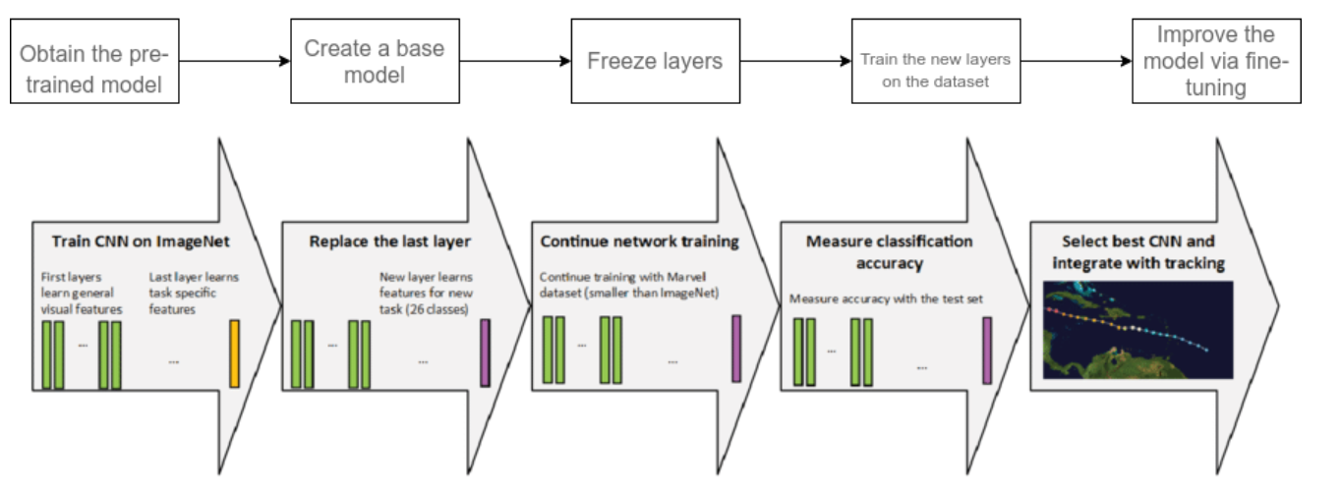
Transfer Learning in 5 steps

Slide 14
Transfer Learning in 6 steps
1. Obtain pre-trained model : The first step is to choose the pre-trained model we would like to keep as the base of our training, depending on the task. Transfer learning requires a strong correlation between the knowledge of the pre-trained source model and the target task domain for them to be compatible.
Here are some of the pre-trained models you can use:
For computer vision:
VGG-16, VGG-19
Inception V3
XCeption
ResNet-50
For NLP tasks:
Word2Vec
GloVe
FastText

Slide 15
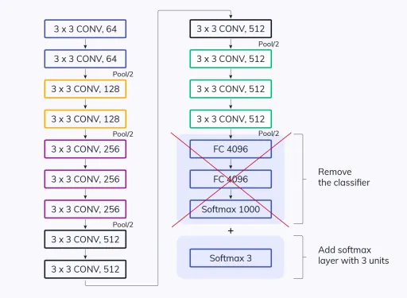
Transfer Learning in 6 steps
2. Create a base model:
The base model is one of the architectures such as ResNet or Xception which we have selected in the first step to be in close relation to our task. We can either download the network weights which saves the time of additional training of the model. Else, we will have to use the network architecture to train our model from scratch.
There can be a case where the base model will have more neurons in the final output layer than we require in our use case. In such scenarios, we need to remove the final output layer and change it accordingly.

Slide 16
Transfer Learning in 6 steps
3. Freeze layers: Freezing the starting layers from the pre-trained model is essential to avoid the additional work of making the model learn the basic features.
If we do not freeze the initial layers, we will lose all the learning that has already taken place.
4. Add new trainable layers: The only knowledge we are reusing from the base model is the feature extraction layers. We need to add additional layers on top of them to predict the specialized tasks of the model. These are generally the final output layers.

Slide 17
Transfer Learning in 6 steps
5. Train the new layers: The pre-trained model’s final output will most likely differ from the output we want for our model. For example, pre-trained models trained on the ImageNet dataset will output 1000 classes.
However, we need our model to work for two classes. In this case, we have to train the model with a new output layer in place.
6. Fine-tune your model: One method of improving the performance is fine-tuning.
Fine-tuning involves unfreezing some part of the base model and training the entire model again on the whole dataset at a very low learning rate. The low learning rate will increase the performance of the model on the new dataset while preventing overfitting.

Slide 18
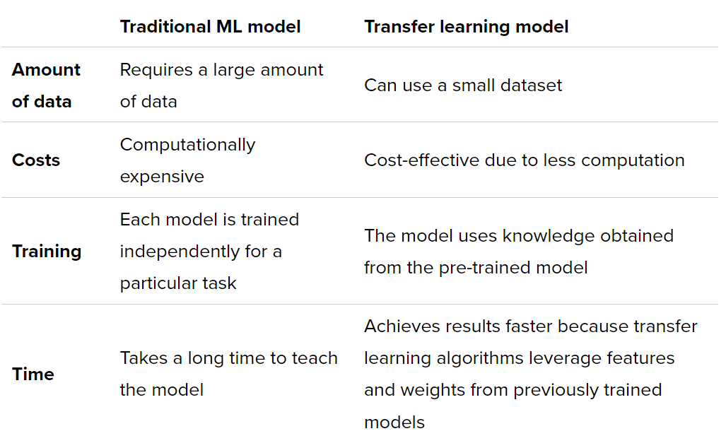
The table below shows the differences between the two approaches.

Slide 19
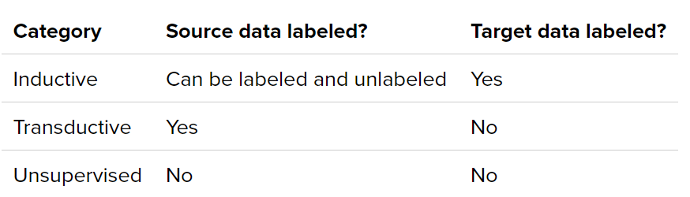
Transfer Learning Methods
Depending on the task and the amount of labeled/unlabeled data available for source and target domains, transfer learning methods fall into one of three categories: inductive, transductive, and unsupervised.

Slide 20
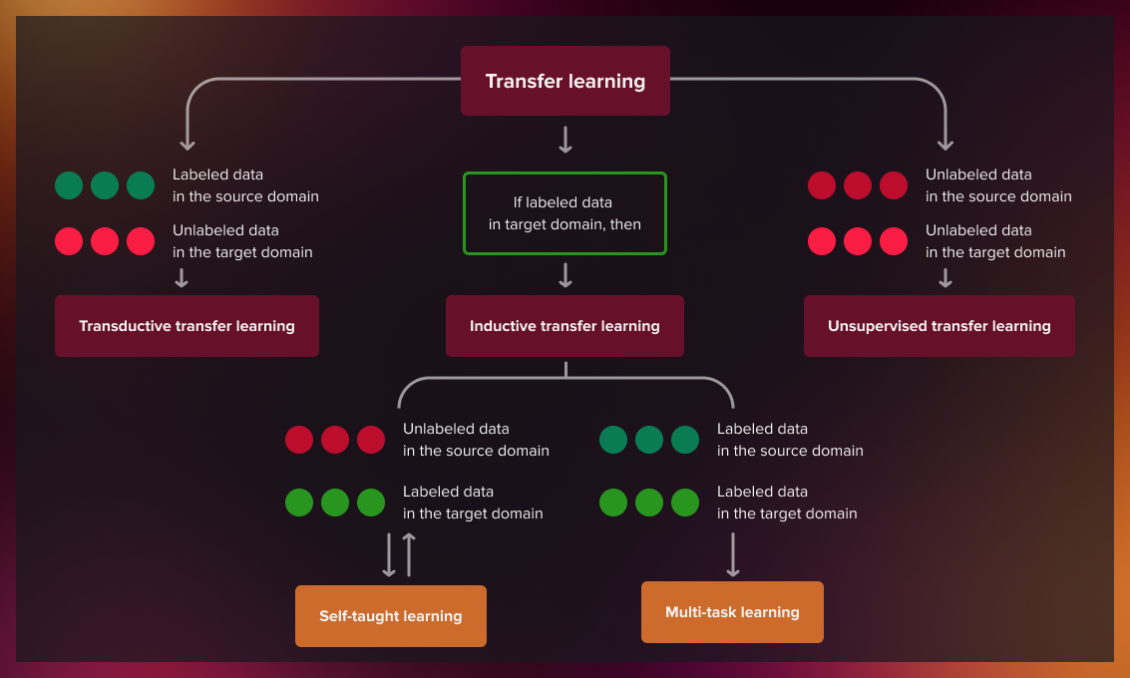
Transfer Learning Methods

Slide 21
Transfer Learning Methodologies
Transfer learning methods can be categorized based on the type of traditional ML algorithms involved, such as:
Inductive Transfer learning: In this scenario, the source and target domains are the same, yet the source and target tasks are different from each other. The algorithms try to utilize the inductive biases of the source domain to help improve the target task. Depending upon whether the source domain contains labeled data or not, this can be further divided into two subcategories, similar to multitask learning and self-taught learning, respectively.

Slide 22
Transfer Learning Methods
Transductive Transfer Learning: The transductive transfer learning approach is used in scenarios where the domains of the source and target tasks are similar but not exactly the same. In these cases, the source domain usually has a large amount of labeled data, and the target domain contains only a limited amount of unlabeled data.
As a practical example of transductive learning, let’s consider reconstructing different emotions for specific individuals for whom we have a limited number of photographs.

Slide 23
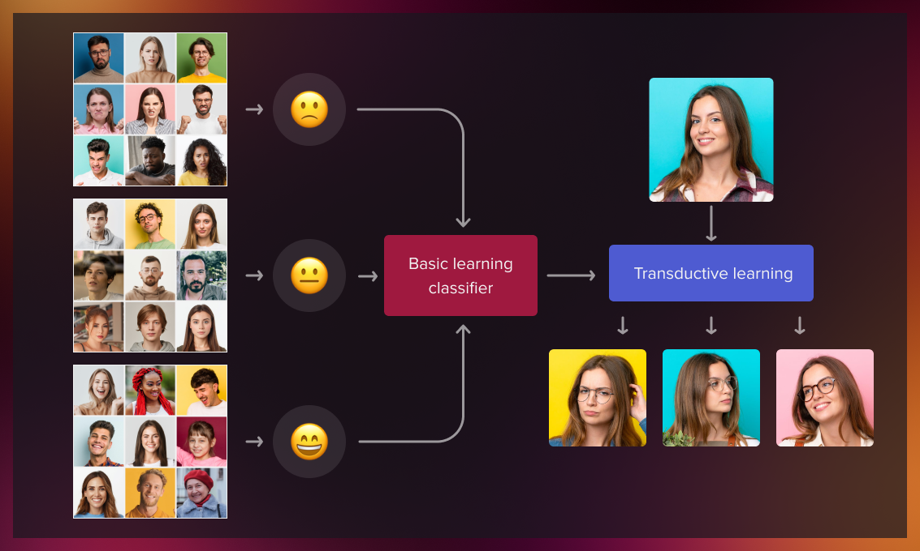
Transfer Learning Methods
Transductive Transfer Learning

Slide 24
Transfer Learning Methods
Unsupervised Transfer Learning: This works similar to inductive transfer, with a focus on unsupervised tasks in the target domain. The source and target domains are similar, but the tasks are different. In this scenario, labeled data is not available for both the source and the target domain. This involves a variety of use cases, the most popular of which is anomaly detection.
Whenever labeling data is time-consuming, labor-intensive, or even impossible, unsupervised transfer learning is the only option.
A real-world example is multispectral pedestrian detection. The error cost for driverless cars misdetecting pedestrians is human life. To train the model, we need to provide many cases with different weather conditions, landscapes, people, additional objects that partially obscure the pedestrians.

Slide 25
Transfer Learning types
Domain adaptation
Domain confusion
Multitask learning
One-shot learning
Zero-shot learning

Slide 26
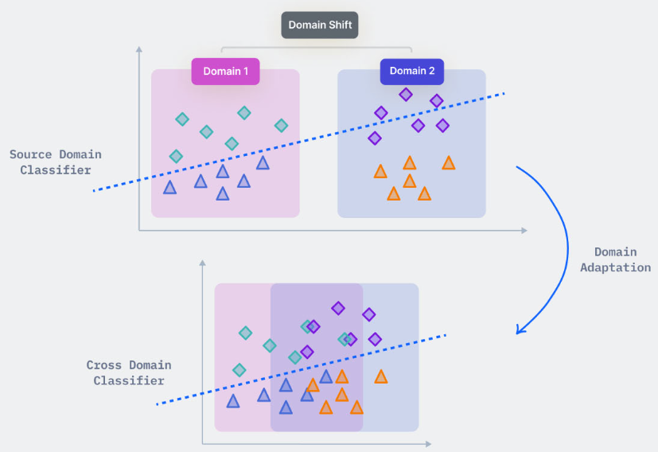
Transfer Learning types
Domain adaptation : Domain Adaptation is a technique to improve the performance of a model on a target domain containing insufficient annotated data by using the knowledge learned by the model from another related domain with adequate labeled data.

Slide 27
Transfer Learning types
Domain adaptation :
Types of Domain Adaptation
We consider three types of domain adaptation. These are defined by the number of labeled examples in the underlying domain:
Unsupervised domain adaptation works with a source domain that has labeled examples, but also unlabeled examples. The target domain only has unlabeled examples.
Semi-supervised domain adaptation expects some of the examples in the target domain are labeled.
Supervised domain indicates that all examples are labeled

Slide 28
Transfer Learning types
Domain confusion: Different layers in a deep learning network capture different sets of features. We can utilize this fact to learn domain-invariant features and improve their transferability across domains. Instead of allowing the model to learn any representation, we nudge the representations of both domains to be as similar as possible.
This can be achieved by applying certain preprocessing steps directly to the representations themselves. The basic idea behind this technique is to add another objective to the source model to encourage similarity by confusing the domain itself, hence domain confusion.

Slide 29
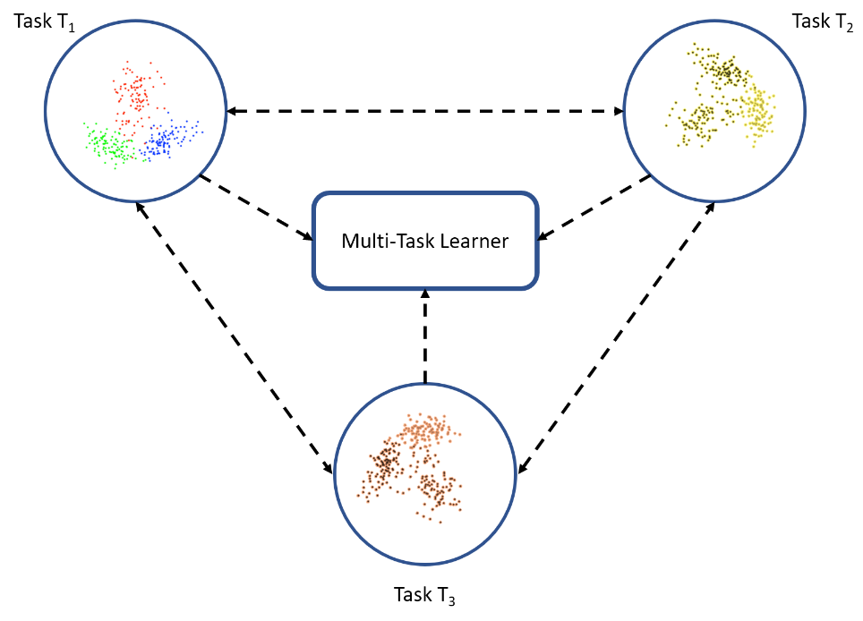
Transfer Learning types
3. Multitask learning: Multitask learning is a slightly different flavor of the transfer learning world. In the case of multitask learning, several tasks are learned simultaneously without distinction between the source and targets. In this case, the learner receives information about multiple tasks at once, as compared to transfer learning, where the learner initially has no idea about the target task.
Multitask learning: Learner receives information from all tasks simultaneously
This is depicted in the following diagram:

Slide 30
Transfer Learning types
4 One-shot learning : The model is trained on 1 sample each from every class. For instance, once a child is shown what an apple looks like, they can easily identify a different variety of apple (with one or a few training examples); this is not the case with ML and deep learning algorithms.

Slide 31
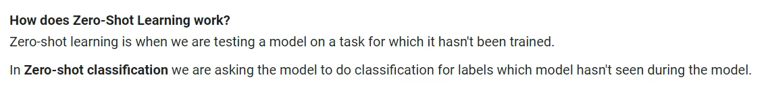
Transfer Learning types
Zero-shot learning: The model is trained in such a way that it is able to classify unseen classes in test dataset. Zero-data learning, or zero-short learning, methods make clever adjustments during the training stage itself to exploit additional information to understand unseen data. So it might be the case in the training dataset we have 5 classes and the test has some 6th class coming as well. Hence, Zero samples for some classes and hence called Zero-Shot Learning
Zero-shot learning comes in handy in scenarios such as machine translation, where we may not even have labels in the target language.

Slide 32
Transfer Learning Applications
Transfer learning for NLP: Textual data presents all sorts of challenges when it comes to ML and deep learning. These are usually transformed or vectorized using different techniques. Embeddings, such as Word2vec and FastText, have been prepared using different training datasets. These are utilized in different tasks, such as sentiment analysis and document classification, by transferring the knowledge from the source tasks.
Transfer learning for Audio/Speech: Similar to domains like NLP and Computer Vision, deep learning has been successfully used for tasks based on audio data. For instance, Automatic Speech Recognition (ASR) models developed for English have been successfully used to improve speech recognition performance for other languages, such as German. Also, automated-speaker identification is another example where transfer learning has greatly helped.
Transfer learning for Computer Vision: Deep learning has been quite successfully utilized for various computer vision tasks, such as object recognition and identification, using different CNN architectures.

Slide 33
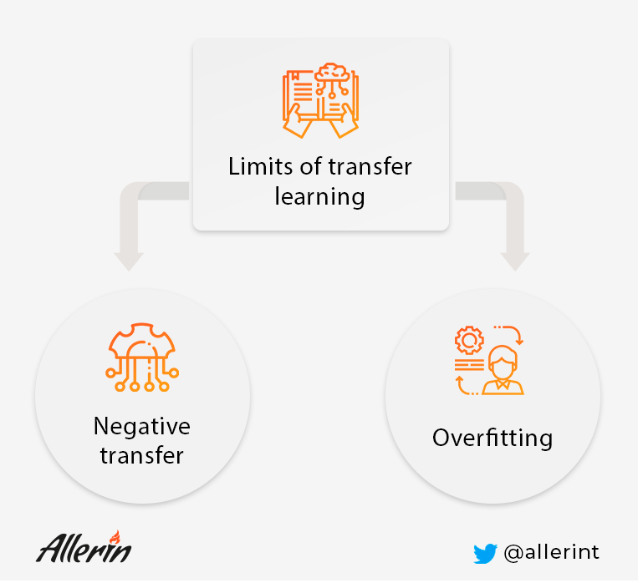
Transfer Learning Challenges

Slide 34
Transfer Learning Challenges
Negative transfer: If the transfer learning ends up with a decrease in the performance or accuracy of the new model, then it is called negative transfer. Transfer learning only works if the initial and target problems of both models are similar enough. If the first round of training data required for the new task is too far from the data of the old task, then the trained models might perform worse than expected. And, regardless of how similar developers may think these two sets of training data are, algorithms may not always agree with them. Currently, there are no specific standards on what tasks are related or how algorithms decide which tasks are related, which makes it challenging to find solutions to negative transfer.

Slide 35
Transfer Learning Challenges
The problem of overfitting
In transfer learning, developers cannot remove the network layers to find optimal AI models with confidence. If they remove the first layers, then it will affect the dense layers as the number of trainable parameters will change. And dense layers can be a good point for reducing layers, but analyzing how many layers and neurons to remove so that the model does not become overfitting is time-consuming and challenging.
Overfitting is a significant limitation for almost all predicting technologies. It is also one of the common biases in big data. But in context to transfer learning, overfitting happens when the new model learns details and noises from training data that negatively impact its outputs.

